Slide 1
Random variable

Slide 2
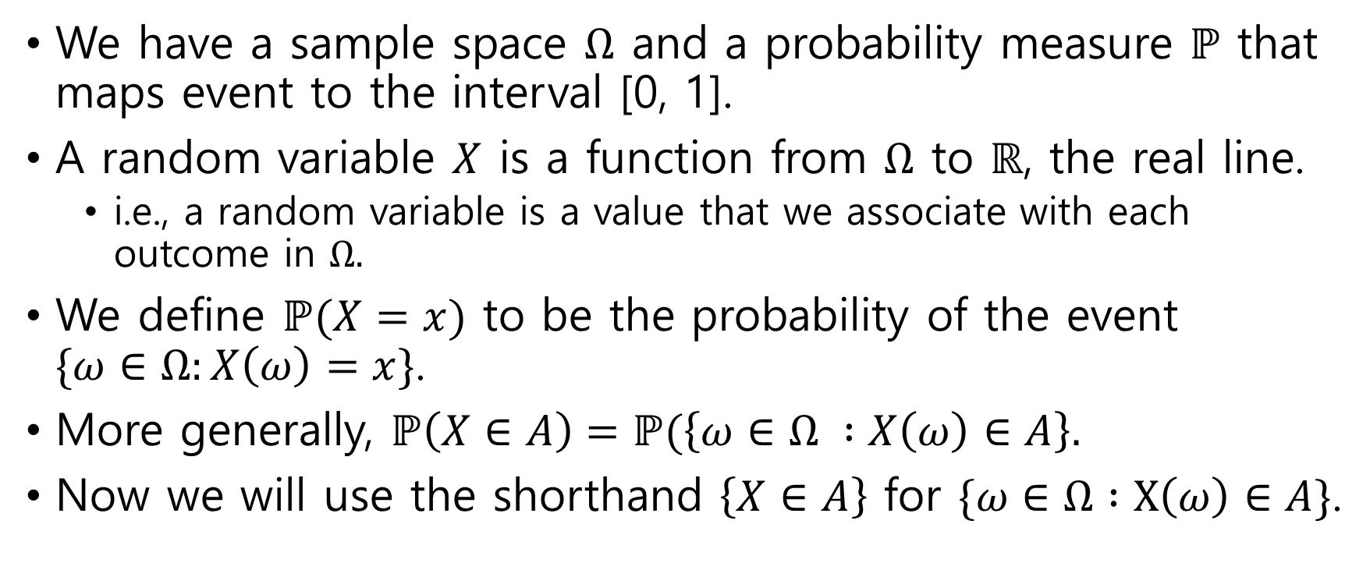
Random variable
We have a sample space $Ω$ and a probability measure $ℙ$ that maps event to the interval [0, 1].
A random variable $X$ is a function from $Ω$ to $ℝ$, the real line.
i.e., a random variable is a value that we associate with each outcome in $Ω.$
We define $ℙ(X=x)$ to be the probability of the event $\{ω∈Ω:X\left(ω\right)=x\}$.
More generally, $ℙ\left(X∈A\right)=ℙ(\left\{ω∈Ω :X\left(ω\right)∈A\right\}.$
Now we will use the shorthand $\left\{X∈A\right\}$ for $\{ω∈Ω :X\left(ω\right)∈A\}$.

Slide 3
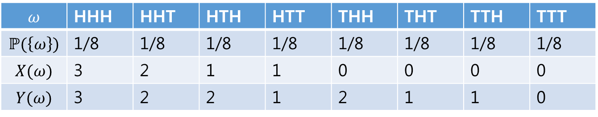
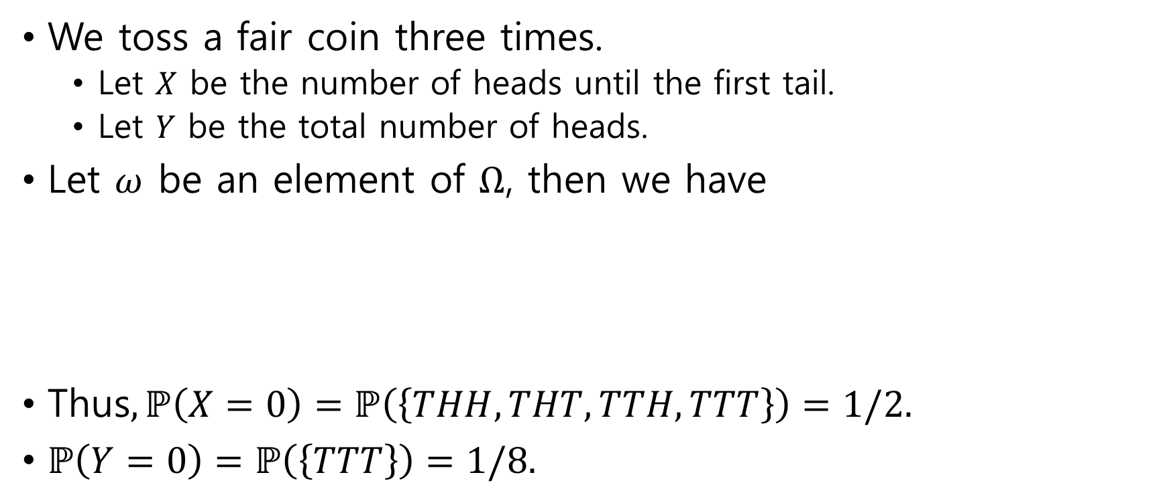
Example of random variable
We toss a fair coin three times.
Let $X$ be the number of heads until the first tail.
Let $Y$ be the total number of heads.
Let $ω$ be an element of $Ω$, then we have
Thus$, ℙ\left(X=0\right)=ℙ\left(\left\{THH,THT,TTH,TTT\right\}\right)=1/2.$
$ℙ\left(Y=0\right)=ℙ\left(\left\{TTT\right\}\right)=1/8.$
$$ω$$ | HHH | HHT | HTH | HTT | THH | THT | TTH | TTT
$$ℙ(\left\{ω\right\})$$ | 1/8 | 1/8 | 1/8 | 1/8 | 1/8 | 1/8 | 1/8 | 1/8
$$X(ω)$$ | 3 | 2 | 1 | 1 | 0 | 0 | 0 | 0
$$Y(ω)$$ | 3 | 2 | 2 | 1 | 2 | 1 | 1 | 0

Slide 4
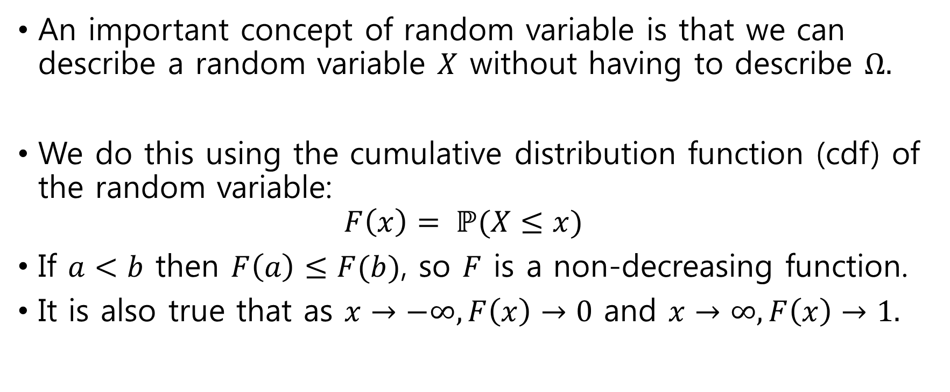
Properties of random variable
An important concept of random variable is that we can describe a random variable $X$ without having to describe $Ω.$
We do this using the cumulative distribution function (cdf) of the random variable: $F\left(x\right)= ℙ(X≤x)$
If $a<b$ then $F\left(a\right)≤F(b)$, so $F$ is a non-decreasing function.
It is also true that as $x→−∞, F\left(x\right)→0$ and $x→∞, F\left(x\right)→1.$

Slide 5
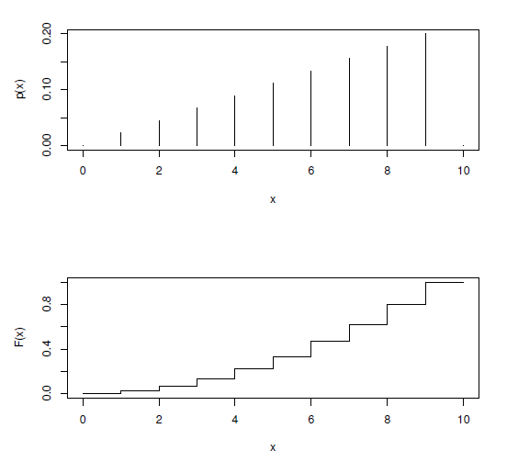
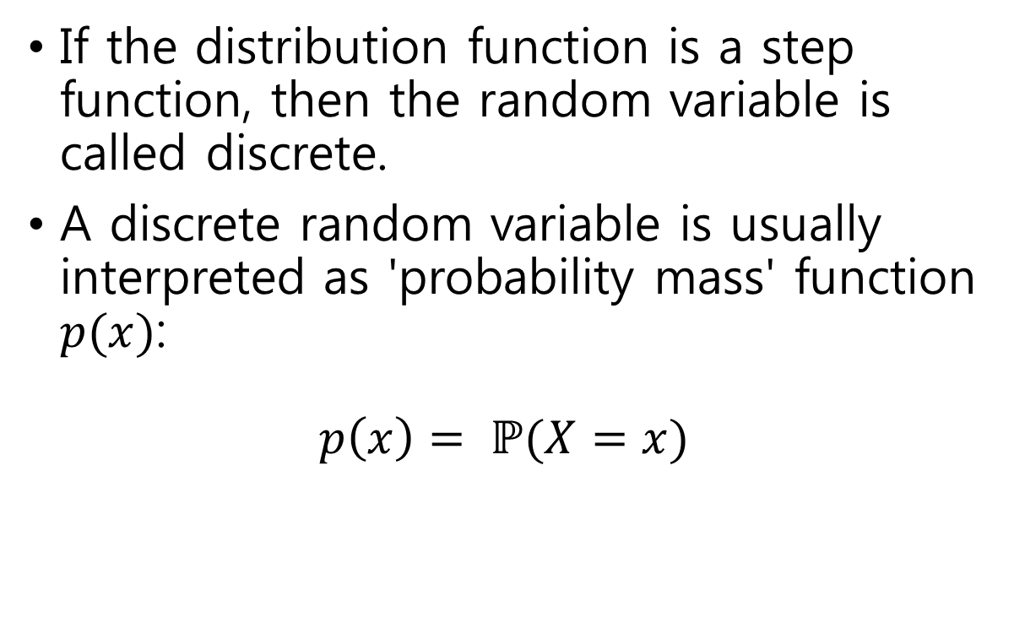
Discrete random variable
If the distribution function is a step function, then the random variable is called discrete.
A discrete random variable is usually interpreted as 'probability mass' function $p(x)$: $p\left(x\right)= ℙ(X=x)$

Slide 6
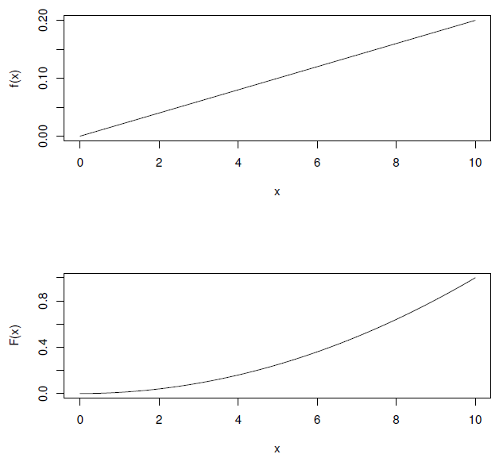
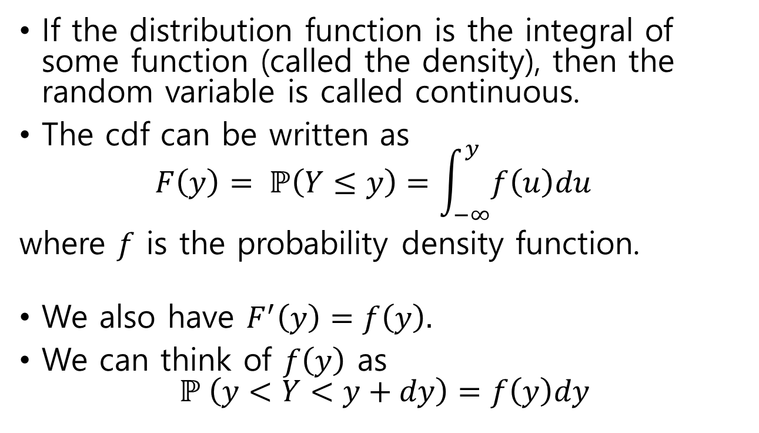
Continuous random variable
If the distribution function is the integral of some function (called the density), then the random variable is called continuous.
The cdf can be written as $F\left(y\right)= ℙ\left(Y≤y\right)=\int_{−∞}^{y}{f\left(u\right)du}$
where $f$ is the probability density function.
We also have $F^{′}\left(y\right)=f\left(y\right).$
We can think of $f\left(y\right)$ as $ℙ \left(y<Y<y+dy\right)=f\left(y\right)dy$

Slide 7
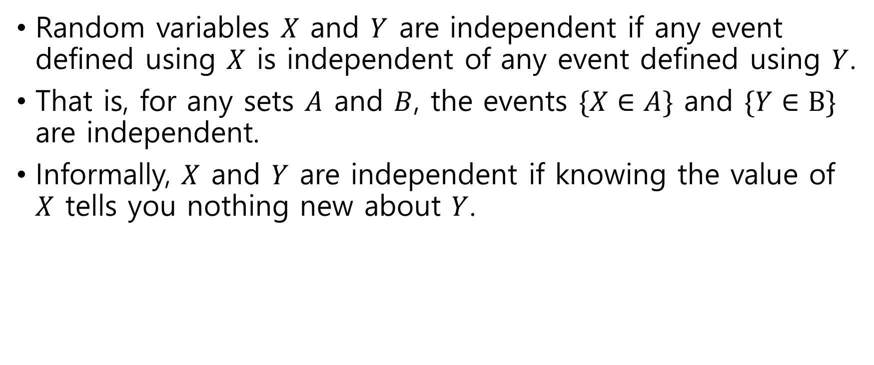
Independent random variables
Random variables $X$ and $Y$ are independent if any event defined using $X$ is independent of any event defined using $Y$.
That is, for any sets $A$ and $B$, the events $\{X∈A\}$ and $\{Y∈B\}$ are independent.
Informally, $X$ and $Y$ are independent if knowing the value of $X$ tells you nothing new about $Y$.

Slide 8
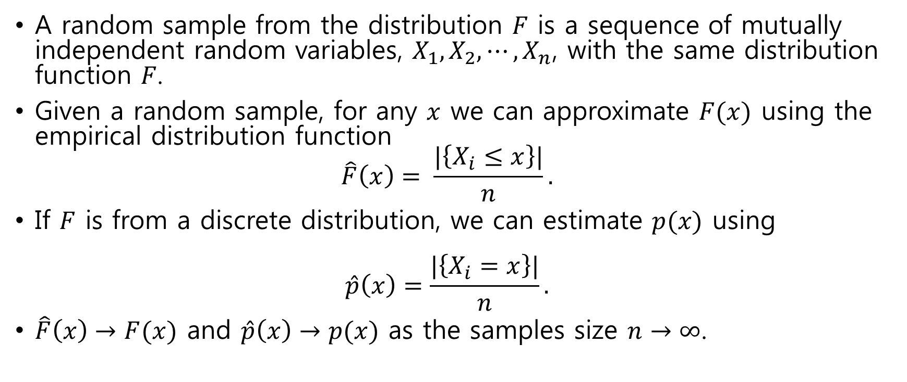
random sample
A random sample from the distribution $F$ is a sequence of mutually independent random variables, $X_{1},X_{2}, ⋯,X_{n}$, with the same distribution function $F$.
Given a random sample, for any $x$ we can approximate $F(x)$ using the empirical distribution function $\hat{F}\left(x\right)= \frac{|\left\{X_{i}≤x\right\}|}{n}.$
If $F$ is from a discrete distribution, we can estimate $p(x)$ using $\hat{p}\left(x\right)=\frac{|\left\{X_{i}=x\right\}|}{n}.$
$\hat{F}\left(x\right)→F(x)$ and $\hat{p}\left(x\right)→p(x)$ as the samples size $n→∞$.

Slide 9
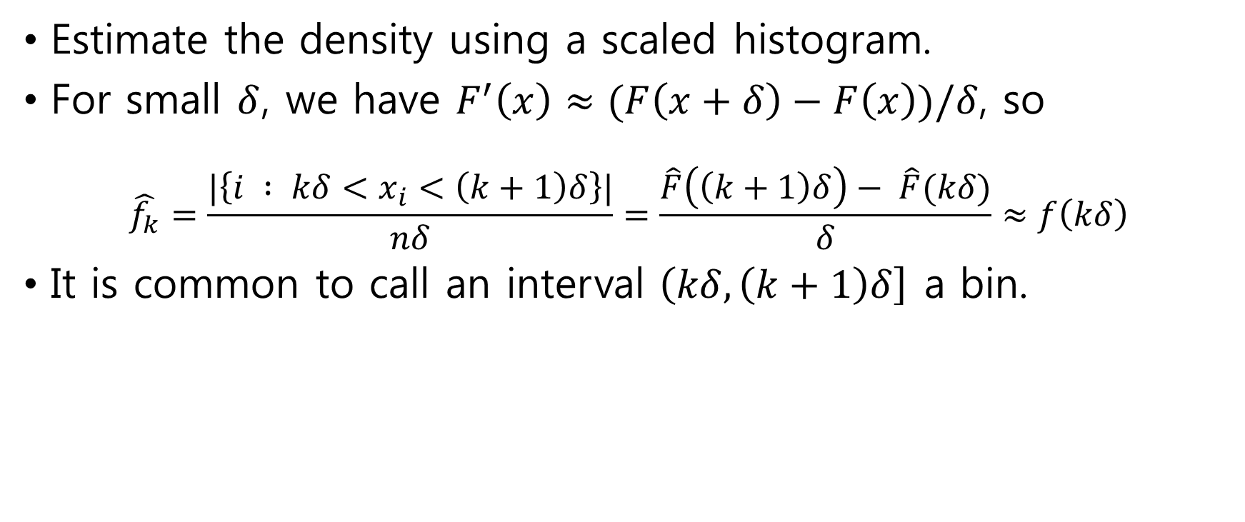
Estimate density
Estimate the density using a scaled histogram.
For small $δ$, we have $F^{′}\left(x\right)≈(F\left(x+δ\right)−F\left(x\right))/δ$, so
$$\hat{f_{k}}=\frac{|\left\{i : kδ<x_{i}<\left(k+1\right)δ\right\}|}{nδ}=\frac{\hat{F}\left(\left(k+1\right)δ\right)− \hat{F}(kδ)}{δ}≈f\left(kδ\right)$$
It is common to call an interval $\left(kδ, \left(k+1\right)δ\right]$ a bin.

Slide 10
Example : Cavendish's experiment
29 measurements of the density of Earth
> cavendish <- c(5.5, 5.57, 5.42, 5.61, 5.53, 5.47, 4.88, 5.62, 5.63, 4.07, 5.29, 5.34, 5.26, 5.44, 5.46, 5.55, 5.34, 5.3, 5.36, 5.79, 5.75, 5.29, 5.1, 5.86, 5.58, 5.27, 5.85, 5.65, 5.39)
some error in the measurement, considered as random.

Slide 11
Example : Cavendish's experiment (2)
R provides built-in functions for plotting the empirical cdf and scaled histogram.
> opar <- par(mfrow=c(2,1), las=1, mar=c(4.2,4,1,1))
> plot(ecdf(cavendish), xlab="Density of the Earth", ylab="Cumulative Freq", main="")
> hist(cavendish, freq=TRUE, breaks=20, xlab="Density of the Earth", ylab="Scaled Hist", main="")
> par(opar)

Slide 12
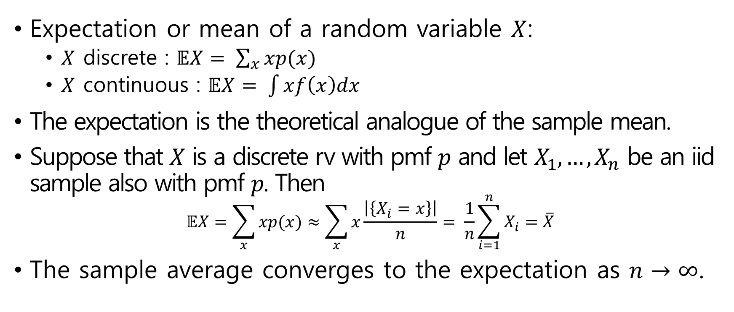
Expectation and finite approximation
Expectation or mean of a random variable $X$:
$X$ discrete : $𝔼X= \sum_{x}{xp(x)}$
$X$ continuous : $𝔼X= \int{xf\left(x\right)dx}$
The expectation is the theoretical analogue of the sample mean.
Suppose that $X$ is a discrete rv with pmf $p$ and let $X_{1}, …,X_{n}$ be an iid sample also with pmf $p$. Then
$$𝔼X=\sum_{x}{xp(x)}≈\sum_{x}{x\frac{\left|\left\{X_{i}=x\right\}\right|}{n}= \frac{1}{n}}\sum_{i=1}^{n}{X_{i}}=\overline{X}$$
The sample average converges to the expectation as $n→∞$.

Slide 13
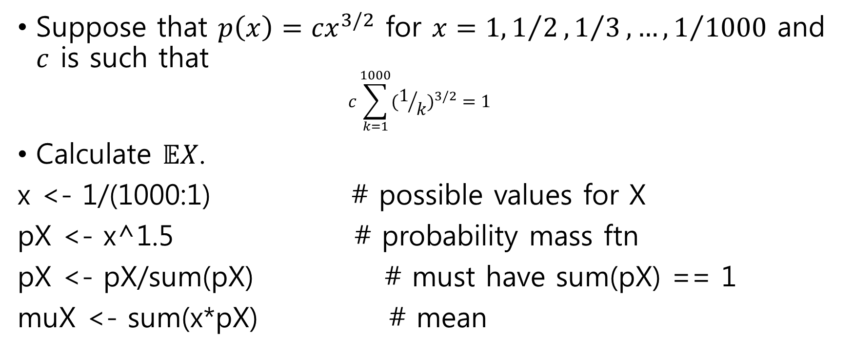
Example: numerical calculation of the mean
Suppose that $p\left(x\right)={cx}^{3/2}$ for $x=1, 1/2, 1/3, …, 1/{1000}$ and $c$ is such that $c\sum_{k=1}^{1000}{{(1/k)}^{3/2}}=1$
Calculate $𝔼X$.
x <- 1/(1000:1) # possible values for X
pX <- x^1.5 # probability mass ftn
pX <- pX/sum(pX) # must have sum(pX) == 1
muX <- sum(x*pX) # mean

Slide 14
Example: numerical calculation of the mean(2)
# plot the pmf and mean
par(las=1)
plot(c(0, 1), c(0, max(pX)), type="n", xlab="x", ylab="p(x)")
lines(x, pX, type="h")
points(muX, 0, pch=19)
text(muX, 0, "mean", pos=4)

Slide 15
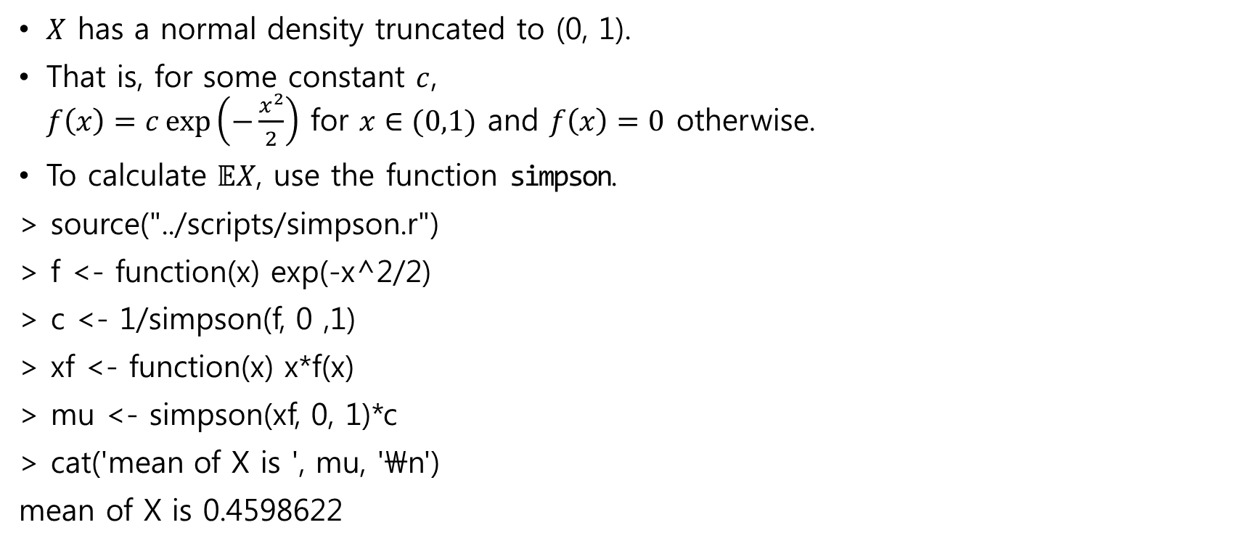
Example : truncated normal
$X$ has a normal density truncated to (0, 1).
That is, for some constant $c$, $f\left(x\right)=c\exp\left(−\frac{x^{2}}{2}\right)$ for $x∈(0,1)$ and $f\left(x\right)=0$ otherwise.
To calculate $𝔼X$, use the function simpson.
> source("../scripts/simpson.r")
> f <- function(x) exp(-x^2/2)
> c <- 1/simpson(f, 0 ,1)
> xf <- function(x) x*f(x)
> mu <- simpson(xf, 0, 1)*c
> cat('mean of X is ', mu, '\n')
mean of X is 0.4598622

Slide 16
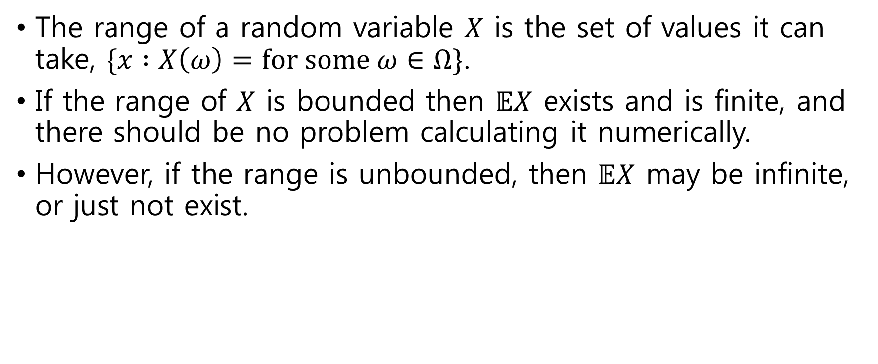
Example : Infinite range
The range of a random variable $X$ is the set of values it can take, $\{x :X\left(ω\right)=\text{for} \text{some} ω∈Ω\}$.
If the range of $X$ is bounded then $𝔼X$ exists and is finite, and there should be no problem calculating it numerically.
However, if the range is unbounded, then $𝔼X$ may be infinite, or just not exist.

Slide 17
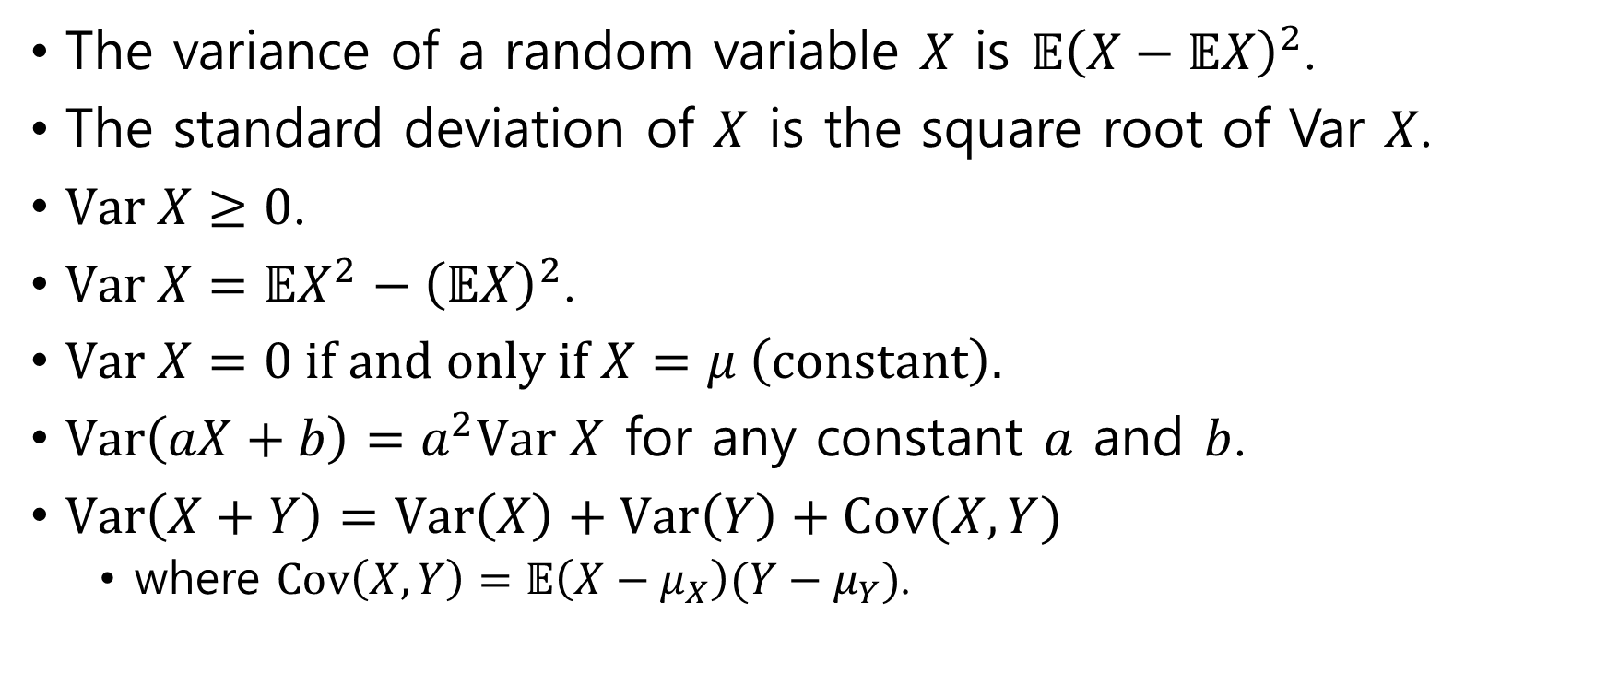
Variance and standard deviation
The variance of a random variable $X$ is $𝔼{\left(X−𝔼X\right)}^{2}$.
The standard deviation of $X$ is the square root of Var $X$.
$\text{Var} X≥0$.
$\text{Var} X=𝔼X^{2}−{\left(𝔼X\right)}^{2}$.
$\text{Var} X=0 \text{if} \text{and} \text{only} \text{if} X=μ \left(\text{constant}\right).$
$\text{Var}\left(aX+b\right)=a^{2}\text{Var} X$ for any constant $a$ and $b$.
$\text{Var}\left(X+Y\right)=\text{Var}\left(X\right)+\text{Var}\left(Y\right)+\text{Cov}(X,Y)$
where $\text{Cov}\left(X,Y\right)=𝔼\left(X−μ_{X}\right)(Y−μ_{Y})$.

Slide 18
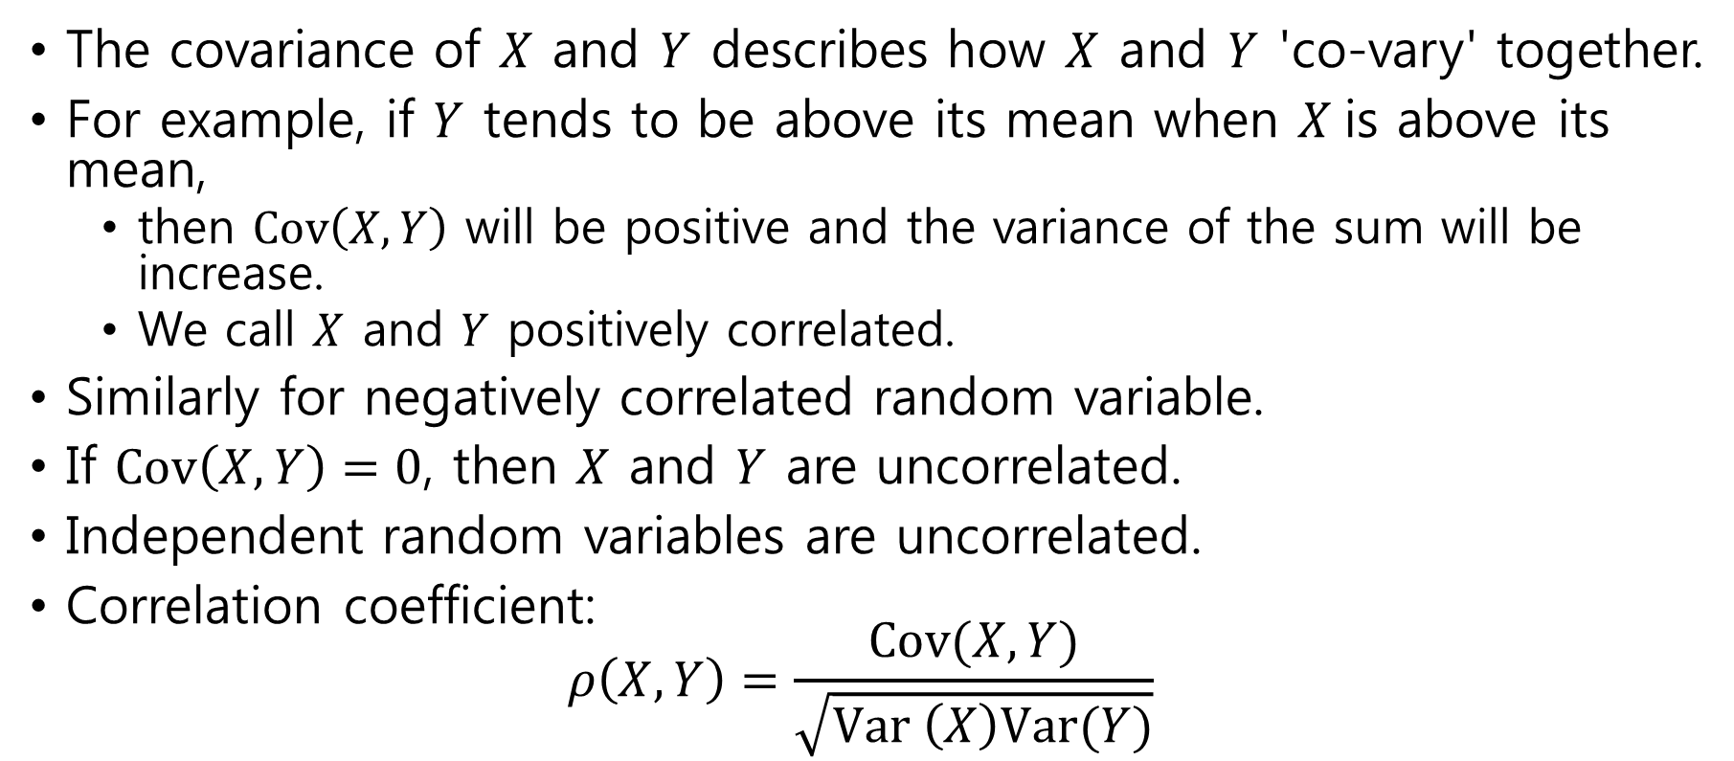
Covariance
The covariance of $X$ and $Y$ describes how $X$ and $Y$ 'co-vary' together.
For example, if $Y$ tends to be above its mean when $X$is above its mean,
then $\text{Cov}\left(X,Y\right)$ will be positive and the variance of the sum will be increase.
We call $X$ and $Y$ positively correlated.
Similarly for negatively correlated random variable.
If $\text{Cov}\left(X,Y\right)=0$, then $X$ and $Y$ are uncorrelated.
Independent random variables are uncorrelated.
Correlation coefficient: $ρ\left(X,Y\right)=\frac{\text{Cov}(X,Y)}{\sqrt{\text{Var} \left(X\right)\text{Var}(Y)}}$

Slide 19
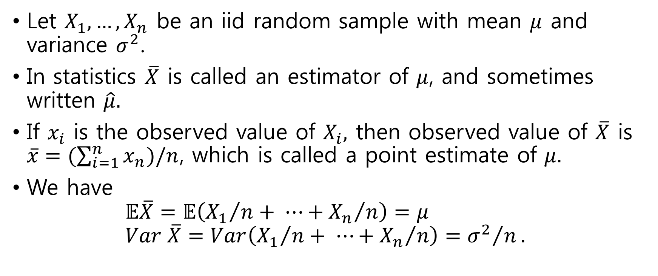
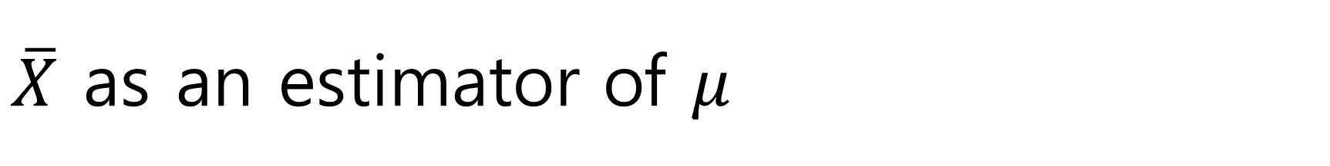
$\overline{X}$ as an estimator of $μ$
Let $X_{1},…,X_{n}$ be an iid random sample with mean $μ$ and variance $σ^{2}$.
In statistics $\overline{X}$ is called an estimator of $μ$, and sometimes written $\hat{μ}.$
If $x_{i}$ is the observed value of $X_{i},$ then observed value of $\overline{X}$ is $\overline{x}=(\sum_{i=1}^{n}{x_{n}})/n$, which is called a point estimate of $μ.$
We have $𝔼\overline{X}=𝔼\left({X_{1}}/n+ ⋯+{X_{n}}/n\right)=μ$ $Var \overline{X}=Var\left({X_{1}}/n+ ⋯+{X_{n}}/n\right)={σ^{2}}/n.$

Slide 20
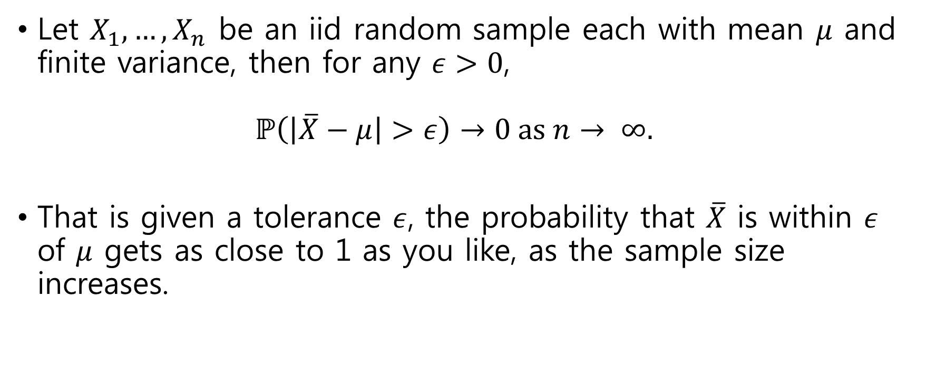
The weak law of large numbers
Let $X_{1}, …, X_{n}$ be an iid random sample each with mean $μ$ and finite variance, then for any $ε>0$, $ℙ\left(\left|\overline{X}−μ\right|>ε\right)→0 \text{as} n→ ∞.$
That is given a tolerance $ε$, the probability that $\overline{X}$ is within $ε$ of $μ$ gets as close to 1 as you like, as the sample size increases.

